Slide 1
“Restaurant Data Analysis”
By
Hemant Gupta
Email- hemantgupta0801@gmail.com
LinkedIn- https://www.linkedin.com/in/hemant-gupta-4914baa6

Slide 2
Overview
In this project, I analyze a large dataset available in the form of a CSV file. The analysis focuses on various parameters related to restaurants, including:
Restaurant Availability: Distribution of restaurants across different locations.
Average Cost: Analysis of average costs by restaurant categories and locations.
Restaurant Categories: Classification and distribution of restaurants by different categories.
Slicers for Filtering Data: Tools for filtering data based on location, restaurant categories, theme-based vs. non-theme-based restaurants, and popular cuisines in each locality.
Theme Based Vs Non- Theme Based Restaurants: Classified the restaurants on theme based and non- theme based with the help of Dax function by using Pie chart in the dashboard.
To achieve these objectives, I utilize various types of visualizations in Power BI, such as:
Donut Chart
Map Visuals
Line Chart
Pie Chart
Matrix Chart

Slide 3
Steps Taken to Analyze the Restaurant Data
Understanding the Problem:
The task involves analyzing the restaurant data based on various parameters to retrieve actionable insights from the dataset.
Data Collection:
Collected raw data in the form of a CSV file.
Imported the data into Power BI Desktop using the 'Get Data' option.
Transformed the data in the Power Query Editor for the data cleaning process.
Data Cleaning:
The raw data contained issues such as null values, unnecessary data, duplicate entries, and blank data fields.
Performed data cleaning in the Power Query Editor.
Loaded the cleaned data into Power BI Desktop to create visuals based on the specified parameters.
Data Analysis:
Created various visualizations, including Donut Charts, Map Visuals, Line Charts, Pie Charts, and Matrix Charts, to analyze the data.
Identified trends and extracted insights from the visualized data on the dashboard.
Interpreting Results:
Derived insights from the dashboard.
Compiled a final report detailing the data analysis findings.

Slide 4
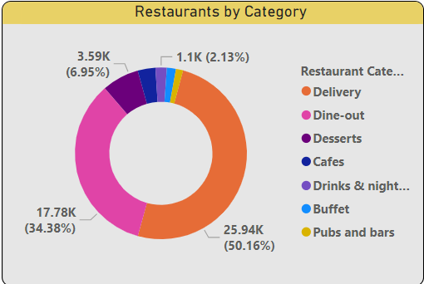
# Restaurants by Category #
Visualization Type: Donut Chart
Insights:- This chart shows the distribution of restaurants
across different categories.
The largest category is "Delivery" with
50.16%.
The second-largest category is "Dine-out" with
34.38%.
Other categories include Cafes, Desserts, Drinks
& Nightlife, and more.

Slide 5
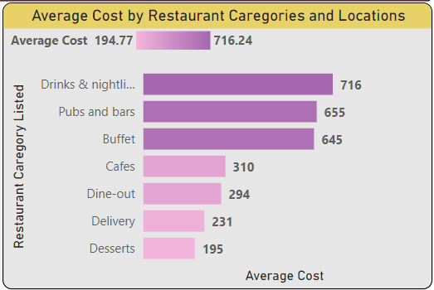
Average Cost by Restaurant Categories and Locations
Bar Chart
Insights:- This chart displays the average cost associated with different restaurant categories.
Drinks & Nightlife have the highest average cost (716.24).
Pubs and bars follow with an average cost of 655.
Other categories like Buffet, Cafes, Dine-out, Delivery, and Desserts have varying average costs with Desserts being the lowest (195).
By using drill-down, we can analyse the location wise average cost of the restaurant.

Slide 6
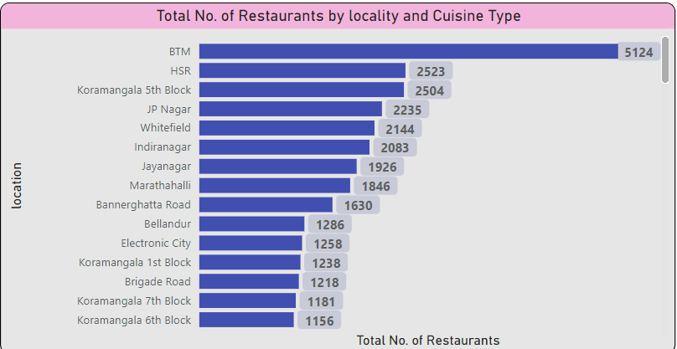
Total Number of Restaurants by Locality and Cuisine Type
Visualization Type:- Bar Chart
Insights:
This chart ranks localities based on the total number of restaurants.
BTM has the highest number of restaurants (5124).
HSR, Koramangala 5th Block, and JP Nagar follow with significant numbers.
This visualization provides a clear view of which localities have the most restaurant options.
By using drill down in the specific bar-chart visuals, we can analyses the cuisine type restaurant data available in the city.

Slide 7
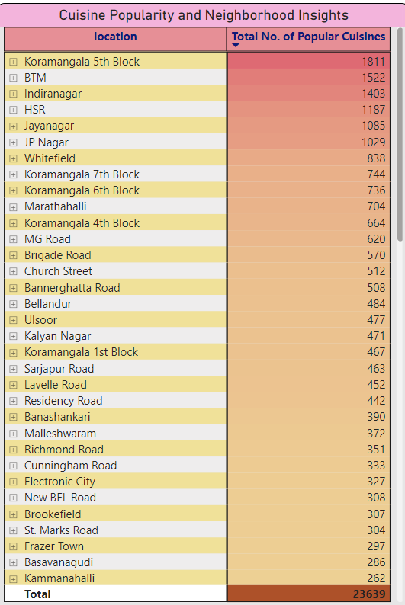
Cuisine Popularity and Neighborhood Insights
Visualization Type:- Heat Map
Insights: This table shows the popularity of different cuisines in various neighborhoods.
Koramangala 5th Block is the most popular with 1811.
Other popular neighborhoods include BTM, Indiranagar, and HSR.
The conditional formatting (heat map) helps in quickly identifying the most and least popular neighborhoods based on the number of popular cuisines.

Slide 8
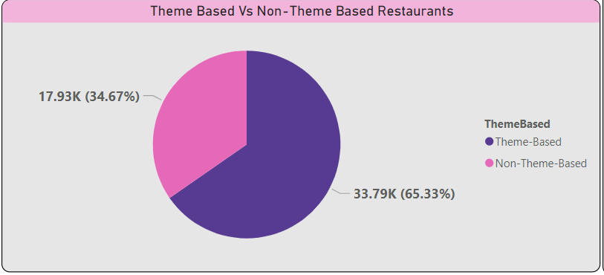
Theme-Based vs Non-Theme-Based Restaurants
Visualization Type:- Pie Chart
Insights:- This chart shows the proportion of theme-
based versus non-theme-based restaurants
- Non-theme-based restaurants constitute the
majority (65.33%).
- Theme-based restaurants make up 34.67
of the total.

Slide 9
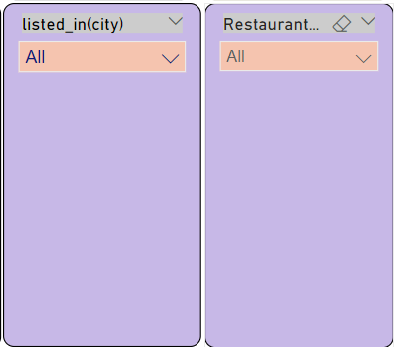
Slicers (Filters) by Location and Restaurant Category
Insights:- To enhance the data analysis process, I utilized slicers in Power BI. Specifically, I implemented slicers based on 'City Location' and 'Restaurant Category.' These slicers provide the following benefits:
Enhanced Specificity: Allows for more granular analysis by filtering data according to specific city locations and restaurant categories.
Improved Interactivity: Adds value to the dashboard by making it interactive, enabling users to explore the data dynamically.
Efficient Data Analysis: Facilitates a more targeted examination of the dataset, helping to uncover detailed insights and trends.
Using slicers, the dashboard becomes a powerful tool for understanding and interpreting the restaurant data in a more meaningful way.

Slide 10
Distribution of Restaurants by Location
Visualization Type: Map Visualization
Insights:- This map shows the geographic distribution of restaurants.
Restaurants are spread across various locations in City.
Different restaurant types are represented by different colored dots on the map.

Slide 11
Thank You

